Slide 1

Effects of Altered Quorum Sensing
Regulatory Networks on
Pseudomonas aeruginosa Pathogenesis
Ava Karanjia
Dr. Heather Bean
Arizona State University
April 18, 2020

Slide 2




Active
Immune System
Decreased Possibility for an Infection
Normal Bacteria

Slide 3




Suppressed Immune System
Increased
Possibility for an Infection
Stressed
Bacteria

Slide 4

Astronaut Fred Haise Jr.
Notes:
Astronaut aboard the Apollo 13 mission, contracted a Pseudomonas aeruginosa infection in his kidneys during the Apollo 13 mission
Oxygen tank exploded on board, astronauts aborted the mission and tried to go home, Fred Haise got a kidney infection with this bacteria

Slide 5
Notes:
PA, QS – chronic lung infections like CF
This is a little girl with CF
defect in CFTR gene: transmembrane regulator
it maintains that balance between chloride and fluid at epithelial cell surface
When disrupted, leads to thick and sticky mucus to buildup in the lungs
This mucus is the perfect place for germs
Especially opportunistic pathogens like PA that take advantage of these immunocompromised individuals
- To combat these infections, antibiotics can target many mechanisms within these pathogens, so understanding the patient’s specific set of isolates becomes crucial to chronic disease prevention

Slide 6
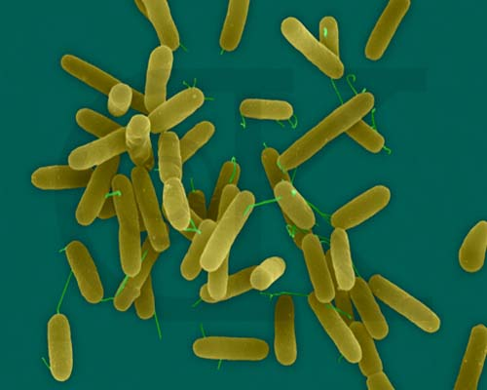


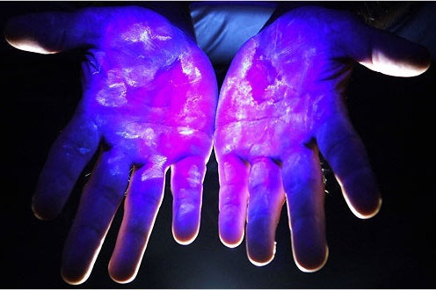
Pseudomonas aeruginosa
www.pbase.com
Pseudomonas.com
shelbycountyswcd.org
nytimes.com
Notes:
opportunistic pathogen
surrounded by the organism: soil, water, on our skin
healthy = no risk
underlying disease: important pathogen

Slide 7
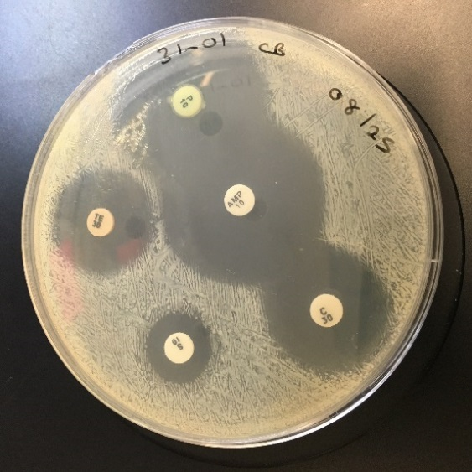
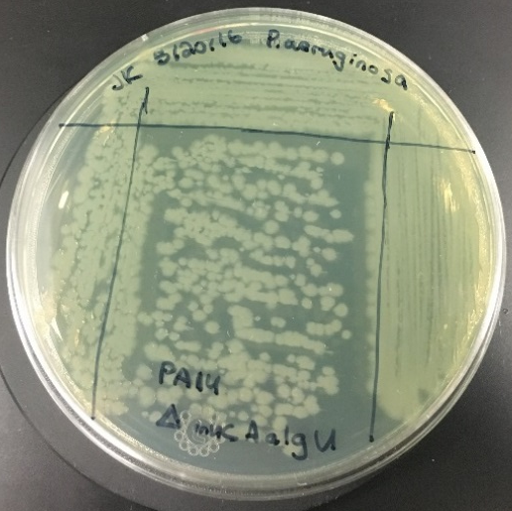
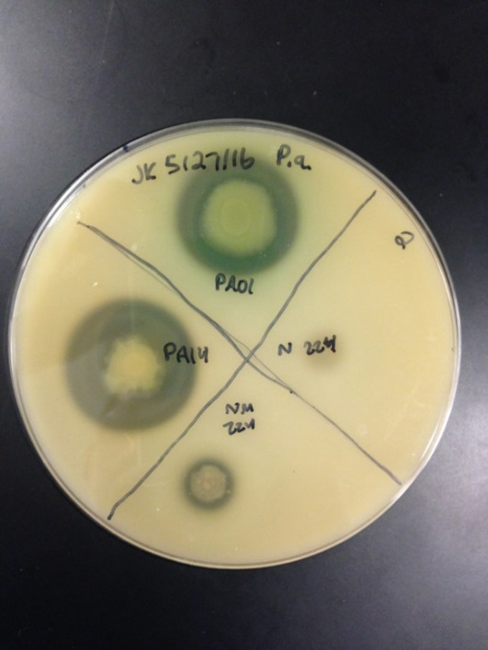
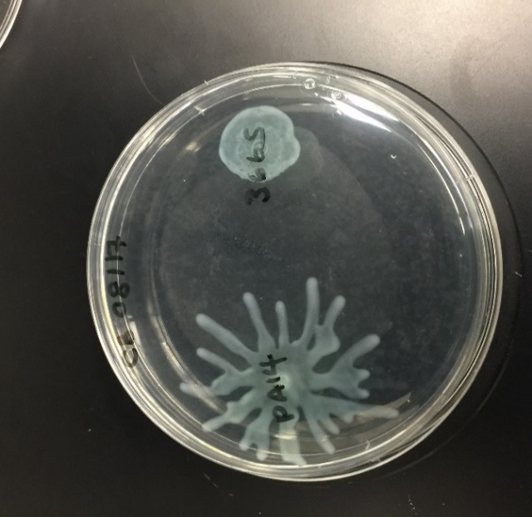
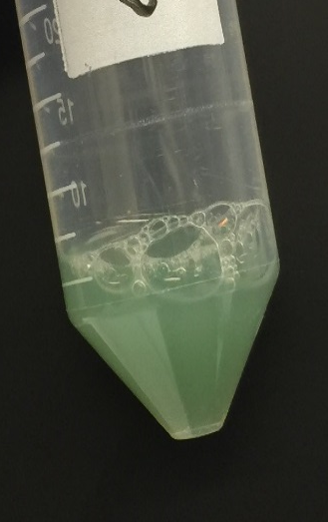
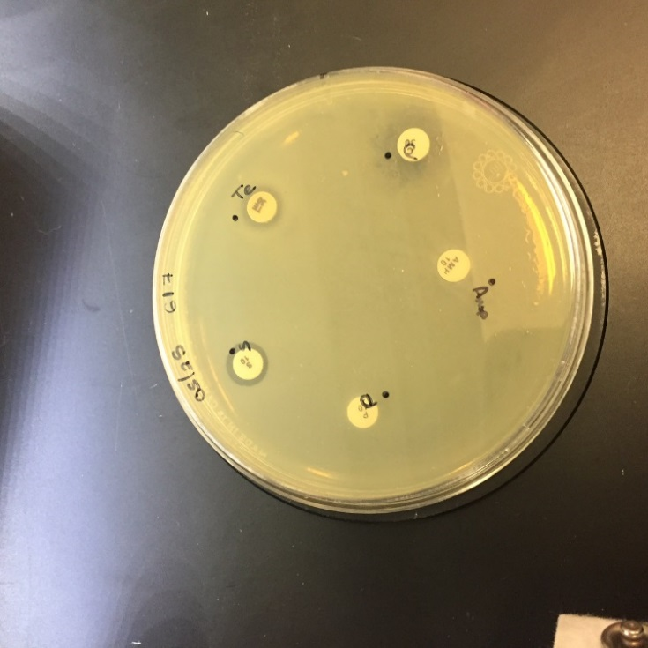
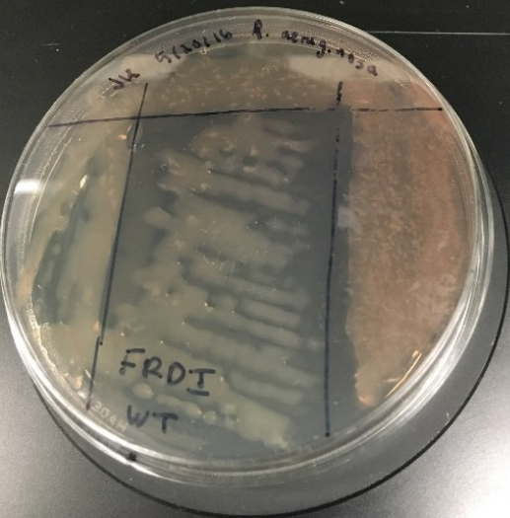

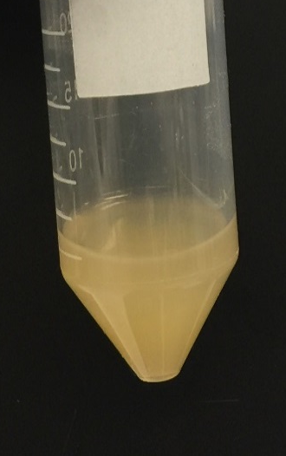
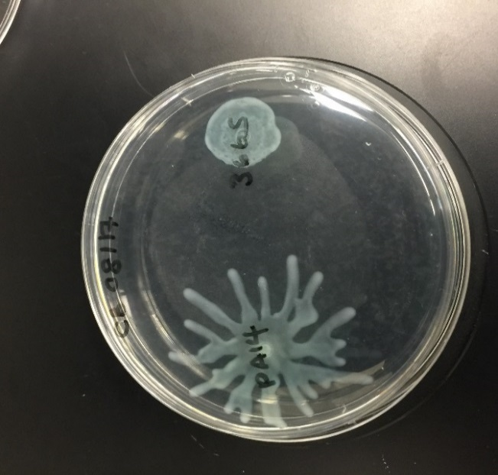
P. aeruginosa adapts in the lung
early
Antibiotic resistance
Mucoidy
Motility
Protease
Pyocyanin
late
QS LOSS OF FUNCTION
Notes:
adapt to their new lung environ
Phenotypic, genomic, metabolomic changes
These changes have been proposed to be biomarkers of infection stage
Preliminary work from other groups: Mayer-Hamblett (UW: Seattle, Seattle Children’s Hospital)
Early: susceptible to AB, non-mucoid, motile, can break down proteins, produce virulence factors (pyocyanin)
Late: AR resistance, slimy, non-motile, stop producing protease, stop QS
Several of these changes: loss of function
Organism is hiding from immune system, don’t need phenotypes
DONT NEED TO ESTABLISH NEW INFECTIONS
already established within the lung
chronic phenotypes: more serious infection
loss of function: typically related to QS phenotypes

Slide 8
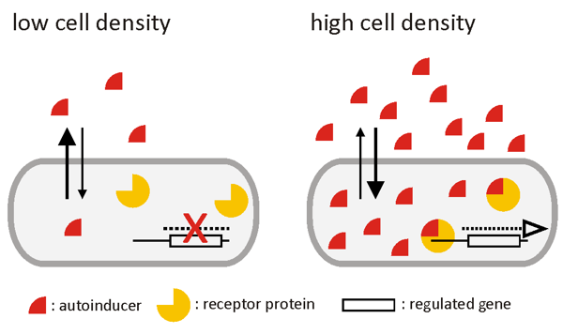
What is Quorum Sensing (QS)?
Individual behaviors
Group behaviors
Schaechter.asmblog.org
Notes:
QS chemical communication
Determine how many counterparts are present before they turn on transcription of certain genes
low CD = still producing autoinducers, lower proportion: not enough to turn on transcription
high CD = autoinducers, bind to turn on transcription of genes
only expressed with sufficient cells

Slide 9
Quorum Sensing in
P. aeruginosa
lasI
rhlI
lasR
rhlR
Notes:
There are a couple QS regulatory mechanisms in PA
Autoinducers, receptors, synthases
High cell density: production of AI
Coordination of group behaviors: antibiotic resistance, and other virulence factors to progress pathogenesis
To understand changes in these regulatory pathways, we quantified exoproduct production of each of these systems
Protease: zone clearance of casein in a milk agar plate.
Pyocyanin: compares the pigment produced to the optical density of the sample
Rhamnolipids: measures the relative quantity of the surfactant via serial dilution

Slide 10
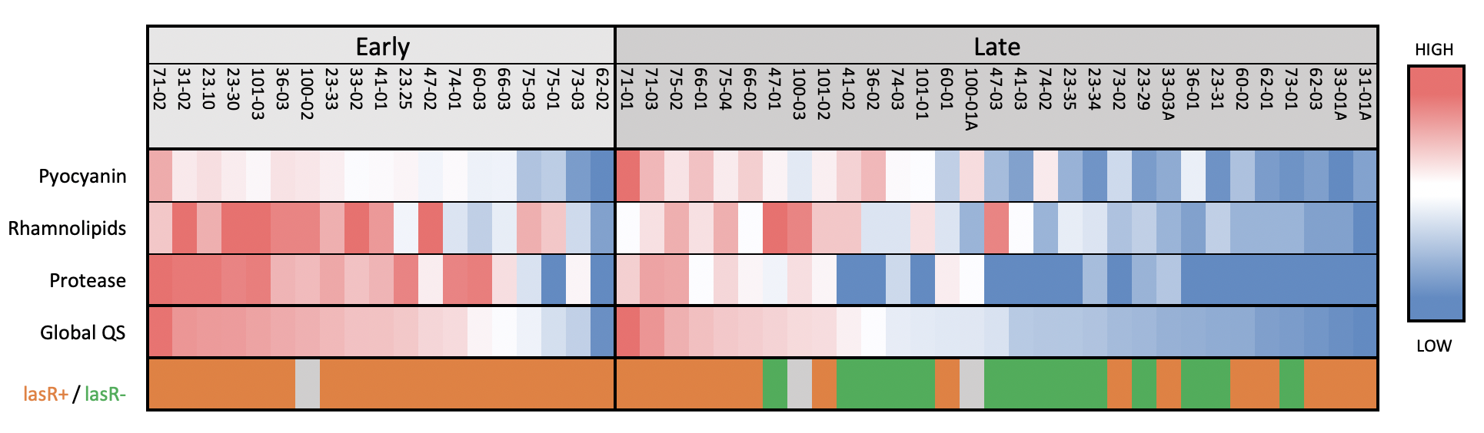
Late chronic infections have reduced QS phenotypes
Notes:
looked at 50 isolates across 16 patients
early/late infection paired isolates, time difference was at least 5 years
pyo, rham, pro: all high in early and low in late
Charted together with the global
even though there is a trend, not a universal change
seen in 62-02
Prot: ability for one QS phenotype to decrease more substantially than others
Not universal change: aspects of CF lung that we would like to observe further

Slide 11
lasR- genotype does not match predicted phenotype
Notes:
Comparison of genotype
Phenotype is not always predicting genotype
lasR- mutations only in 11/20 (little over 50% of isolates)
Other regulatory components at play

Slide 12
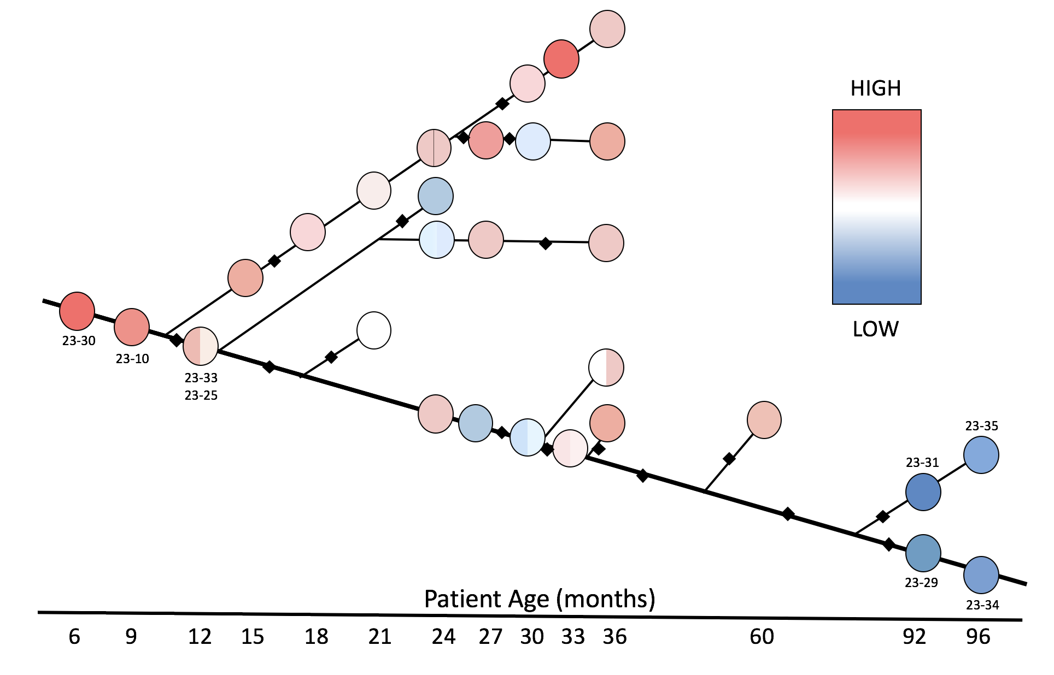
Phenotypic biomarkers help to understand the
PA genome
Adapted from Smith, E.E., et al. (2006) PNAS 103: 8487-8492.
Notes:
QS scores
35 isolates described earlier by EE Smith
We conduct the three assays for each isolate, global set across isolates is represented in this tree
general trend: lose QS regulated phenotypes
interesting features: how branches maintain
evidence that these populations maintain high QS with low QS isolates
what are the phenotypes of that infection?
mixed populations
are they more like early or late infection characteristics
evidence that might look like recovery
3 options
- restoration in gene
- or compensatory gene (dependency between lasR/rhlR)
- undersampling problems
diminished: is there compensations?
sequencing effort

Slide 13
Phenotype do not
predict genotype
in all cases
lasR-
Adapted from Smith, E.E., et al. (2006) PNAS 103: 8487-8492.
Notes:
When we look at lasR deletions again, we see that it’s not attributing the effects that we are observing
- There are other regulatory mechanisms at play

Slide 14
Conclusions
Phenotypes can predict late-like or chronic infections
Recovery of
initial QS abilities
Co-culture of different mutations
Phenotypes do not
predict genotypes
in all isolates
Adapted from Smith, E.E., et al. (2006) PNAS 103: 8487-8492.

Slide 15
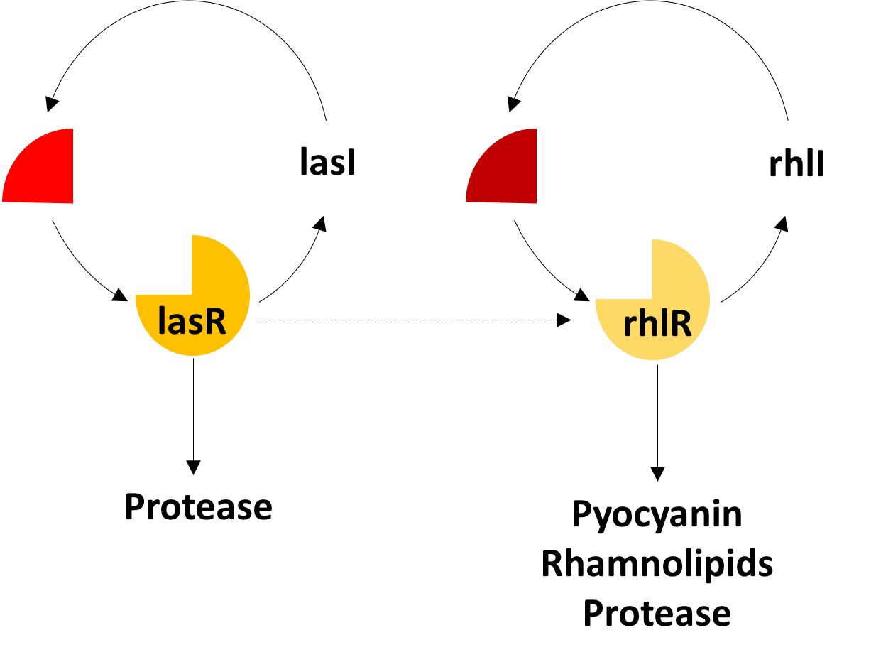
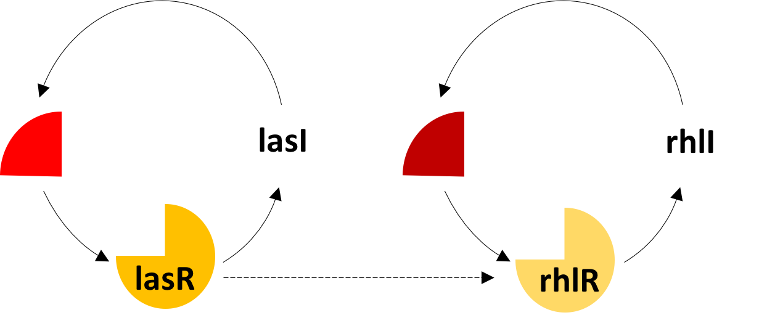
Future Directions
Quantify signaling molecules
Phenotypic changes in result of Δ, ΔΔ, ΔΔΔ, ΔΔΔΔ mutant standards

Slide 16



Acknowledgements
Bean Lab: Biomedicine and Biotechnology, ASU:
Dr. Heather D. Bean
Support:
Cystic Fibrosis Foundation, CF Isolate Core at Seattle Children’s Research Institute, ASU SOLUR Program, NASA/ASU Space Grant Program

Slide 17
Questions?

